Slide 1
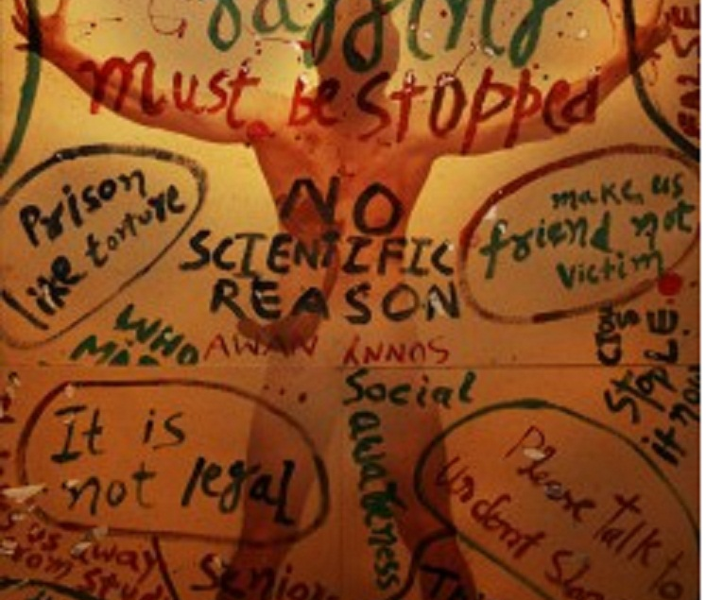
RAGGING: A MENACE

Slide 2
What is Ragging?
The Supreme Court Of India has defined ragging as –
"Ragging is any disorderly conduct, whether by words spoken or written, or
by an act which has the effect of teasing, treating or handling with
rudeness any student, indulging in rowdy or undisciplined activities
which cause or are likely to cause annoyance, hardship or psychological
harm or to raise fear or apprehension thereof in a fresher or a junior
student and which has the effect of causing or generating a sense of shame
or embarrassment so as to adversely affect the psyche of a fresher or a
junior student. “
In simpler terms, Ragging is a systematic human rights abuse practiced by the seniors on the freshers so as to exert their dominance over the juniors.

Slide 3

Where has Ragging come from?
The ragging problem is a legacy of the British, who imported the practice to India from elite public schools back home.
But while experts say extreme forms of hazing have all but disappeared in Britain, they continue in India and other Asian countries
Countries affected by Ragging -
USA
India
Sri Lanka

Slide 4
The Evil
Of Ragging
Can result in physical injury due to beating, hitting with the help of objects, or due to tasks performed against a person’s will.
Psychological fear due to intense fear.
It is an abuse of human rights.
Can lead to forceful initiation on alcohol and drugs.
Sometimes, people are so affected by ragging, that they tend to drop out of college.
It leads to mob mentality and mindset.
Can also result in deaths.
“Well, their first months in IIT were traumatic to say the least. They would cry in front of me. They couldn’t take in the humiliation of ragging. The humiliation of being stripped totally naked and being made to run around the IIT Delhi campus... The engineering and medical colleges of India are the havens of the worst possible ragging in this country.“
-Management Guru : Arindam Chaudary

Slide 5
Myths And Facts Of Ragging
MYTHS
FACTS
Ragging makes a student bold and prepares us for the difficult circumstances in Life. It makes us strong.
Ragging helps in breaking the ice between the seniors and freshers. It helps in their interaction and developing friendship between them.
Boldness as instilled by ragging is a weak acceptance of fate by victims. It teaches us how to be exploited and mutely, non-resistively accept it.
Ragging is an archaic method of interaction with several harmful effects. Today with advance psychological science there are many other healthy ways of interaction which are more effective and without any human rights abuse.

Slide 6

Myths And Facts Of Ragging
MYTHS
FACTS
Ragging generates a feeling of unity and Oneness.
Ragging divides the students on the lines of caste, region, class etc. It sets mob mentality in the students.

Slide 7
The Psychology Behind Ragging
Discrimination based on caste, region, language, class etc plays a vital role in influencing it, especially in small cities and towns.
Ragging is used as a measuring rod to test the courage of the seniors. Many seniors who are reluctant to rag, finally succumb to peer pressure. Many seniors rag just to stay in their group of friends.
In many instances it starts as a healthy interaction but due to adrenaline rush and excitement in the group, the seniors get carried away and ragging turns ugly.
Students consider ragging as an old ritual having social acceptance

Slide 8
The Anti-Ragging Act
Indian Penal Code. Punishment under the following IPC sections
294 – Obscene acts and songs
323 – punishment for voluntarily causing hurt
324 – voluntarily causing hurt by dangerous weapon or means
325 – punishment for voluntarily causing grievous hurt
326 – voluntarily causing grievous hurt by dangerous weapon
339 – Wrongful Restraint
340 – Wrongful Confinement
341 – Punishment for Wrongful Restraint
342 – Punishment for Wrongful Confinement
506 – Punishment for culpable homicide not amounting to murder

Slide 9
The Punishments
UGC Regulations On Curbing The Menace Of Ragging In Higher Educational Institutions, 2009
1. Cancellation of admission.
2. Suspension from attending classes.
3. Withholding/withdrawing scholarship/fellowship and other benefits.
4. Debarring from appearing in any test/examination or other evaluation process.
5. Withholding results.

Slide 10
The Punishments
6. Debarring from representing the institution in any national or international meet, tournament, youth festival, etc.
7. Suspension/expulsion from the hostel.
8. Rustication from the institution for periods varying from 1 to 4 semesters or equivalent period.
9. Expulsion from the institution and consequent debarring from admission to any other institution.
10 Fine up to Rs. 25,000/-

Slide 11
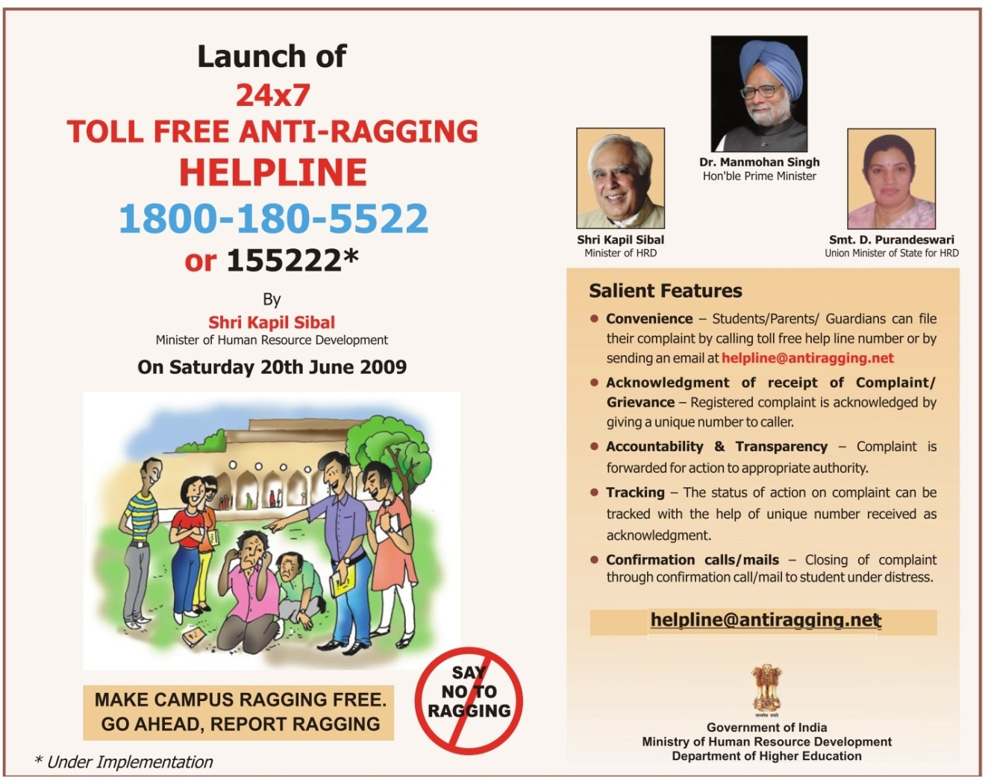
Anti- Ragging Helpline

Slide 12
Conclusion
Ragging has crossed all limits .
The Indian govt has banned ragging , but still we hear many incidents year after year .
LET US PUT A STOP,
LET US MAKE A DIFFERENCE,
LET US JOIN HANDS
AND PUT AN END TO THIS EVIL!

